Slide 1
A Real Time Application to Identify Alcoholics from ECG Signals
Akarsh N Kolekar (1PI13EC009) Guide: Dr. b Niranjana Krupa
Apoorv Vatsal (1PI13EC017)
Rakshith Vishwanatha (1PI13EC075)

Slide 2
Work Done By First Review
RAKSHITH
Time domain feature extraction
Non linear feature extraction
APOORV
Raspberry pi setup
Frequency domain feature extraction
AKARSH
Circuit design/simulation
Introduction to ELM classifier

Slide 3
Work Done By Second Review
RAKSHITH
Implemented SVM Classifier on MATLAB
Started Porting Code onto Python
Started work on Circuit and interface with Raspberry-Pi
APOORV
Converted all MATLAB toolbox operations to MATLAB scripts
Worked on AR Modelling. Started work on ARX.
Started work on Circuit and interface with Raspberry-Pi
AKARSH
Implemented ELM Classifier on MATLAB
Implemented ELM Classifier on Python
Started work on Circuit and interface with Raspberry-Pi

Slide 4
Work Done Since Last Review
RAKSHITH
Trained and tested SVM for unbiased dataset with crossvalind()
80% - 90% accuracy
Earlier, biasing and self-written k-fold code gave 98% accuracy)
Feature reduction techniques -- PCA and Combinational Selection
PCA could reduce 23 features to just 2 dimensions with 80% accuracy
Realised that PCA was not required to select features
But it showed high correlation in features being extracted – can expect good reduction though comnk()
Combination Selection done using combnk()
Number of essential features was reduced to just 17 features
Accuracy retained at 88%

Slide 5
Work Done Since Last Review
RAKSHITH
Completed porting time domain, non-linear feature extraction MATLAB code to Python
Worked on designing filters for ECG sensor
LPF and HPF range for filters studied and implemented
Notch filter designed and soldered

Slide 6
Circuit – Design
Original circuit had just the instrument amplifier and LPF
We got 50 Hz signals with superimposed ECG signal
Decided to remove 50Hz using a Twin T notch filter
Fc = 50Hc, Q = 0.75
Met Dr. Maruthy to discuss more about circuit design and placement of leads of the sensor
Also go additional inputs about using Audacity for off-site filtering

Slide 7
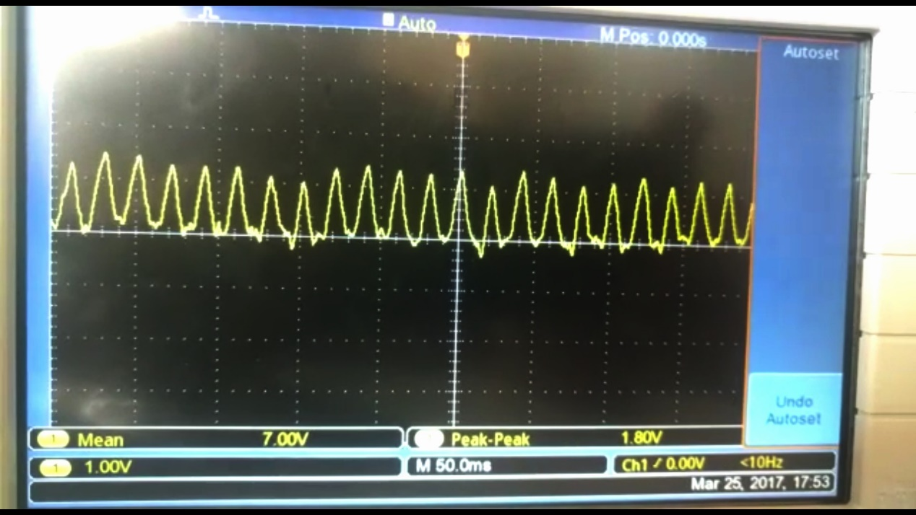
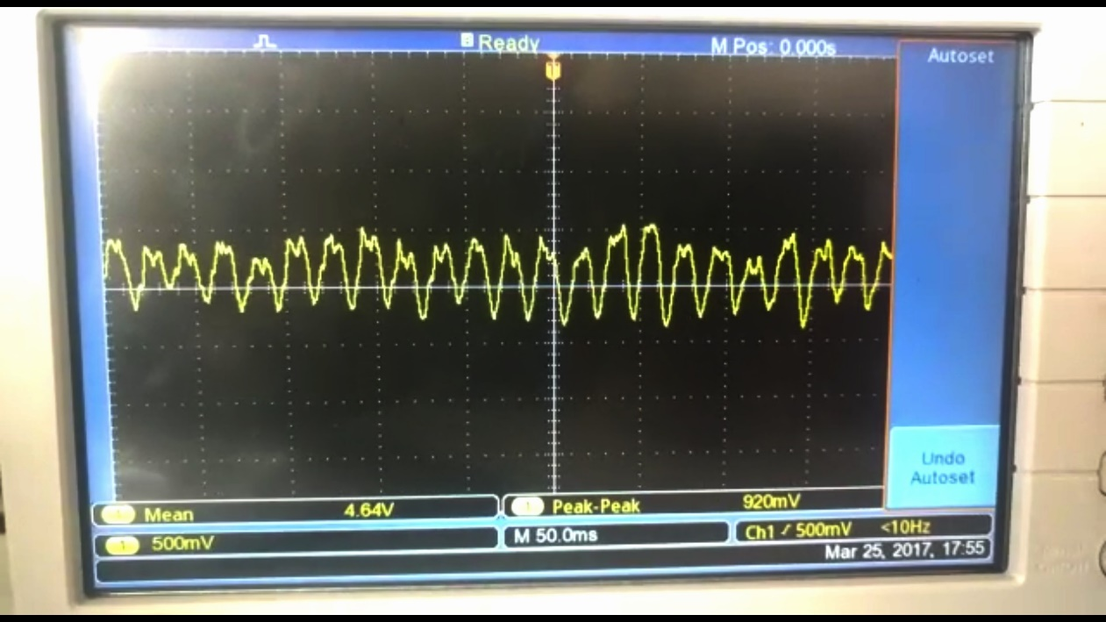
Circuit – Design
Clean 50 Hz signal
Original Circuit
ECG signal superimposed on 50Hz

Slide 8
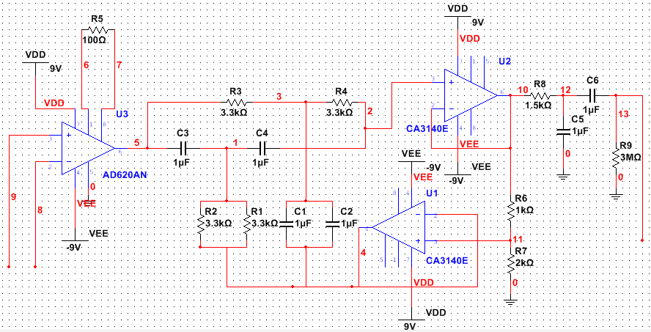
Circuit – Design
New circuit tried on breadboard
Promising results (signal spikes every 1.2s) but unstable
Implementing soldered version

Slide 9
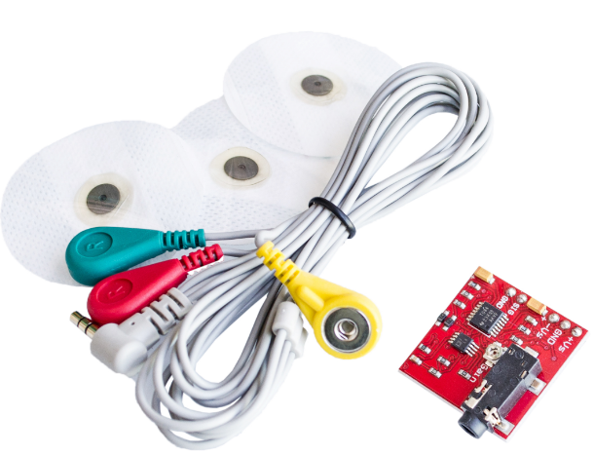
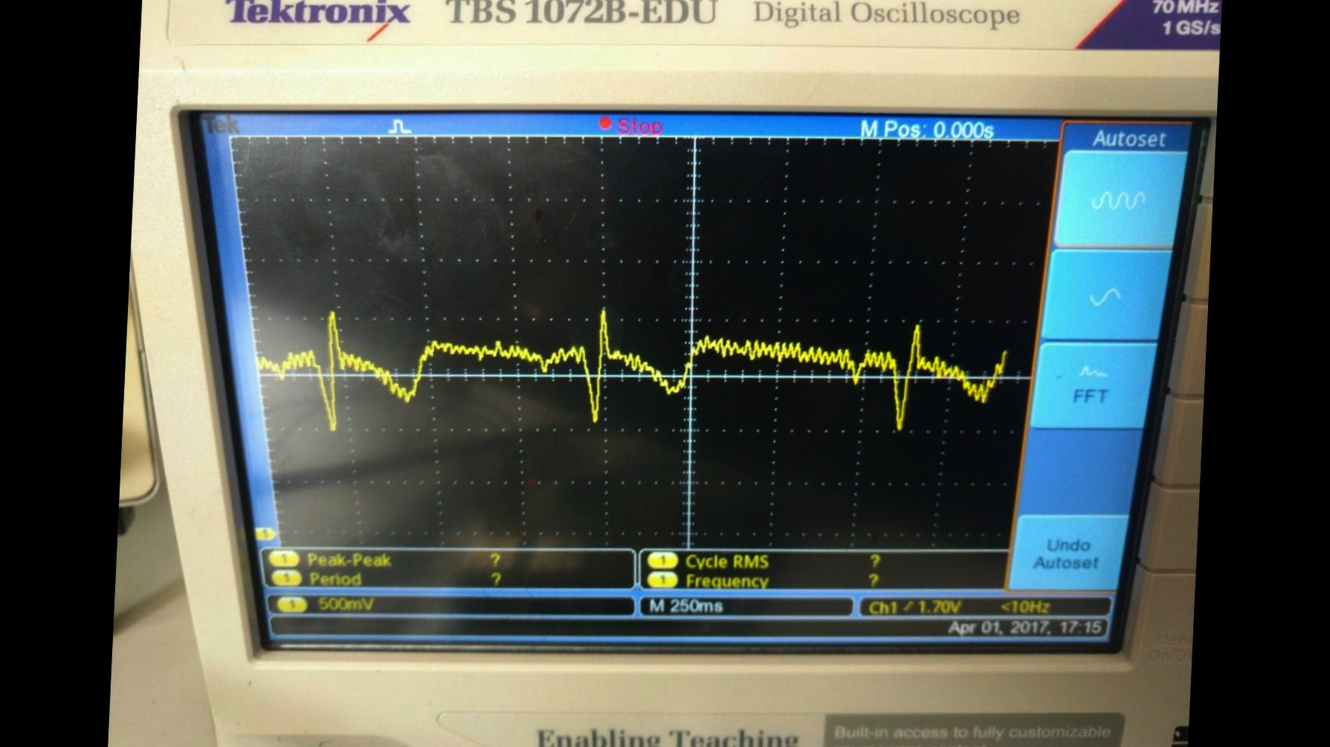
Alternative Sensor
As an alternative, we have used an AD8238 ECG sensor to obtain ECG signals on the CRO
Worked on R-pi to sample signals at required 1KHz
Sampled signal is stored as a CSV
AD8232 with ECG sticky pads
Output on CRO

Slide 10
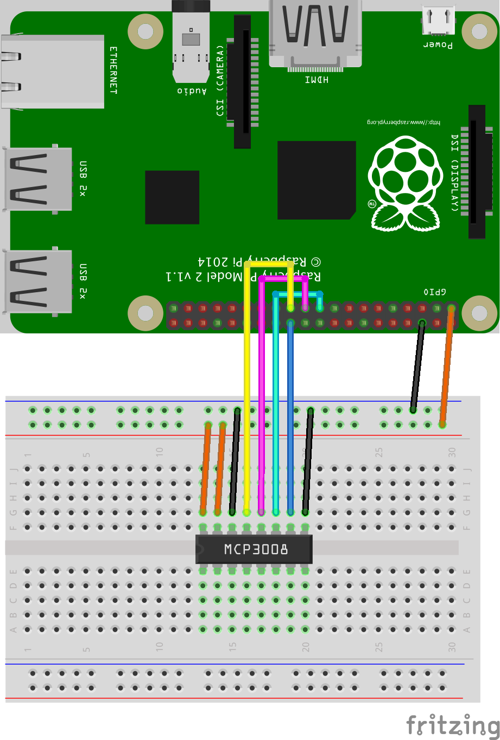
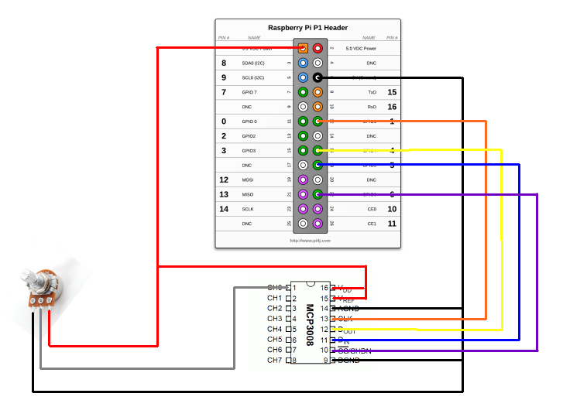
Sensor Interface with R-pi
Interface diagram of Analog sensor with MCP 3008 ADC
1kHz sampling required without being able to find actual sampling rate of the DAC – timer() class

Slide 11
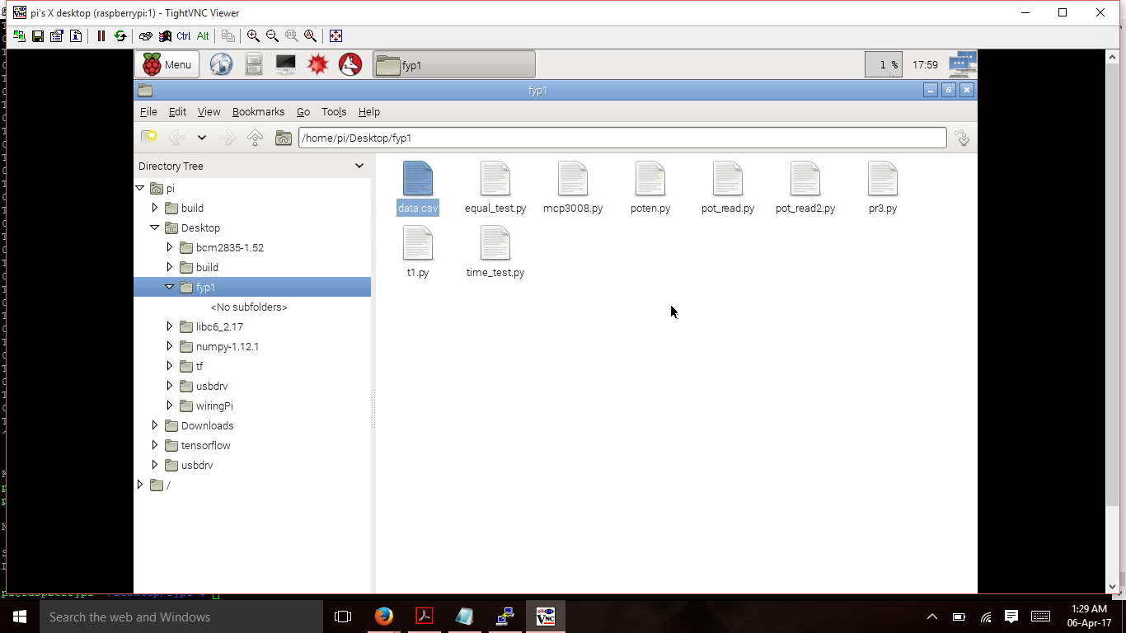
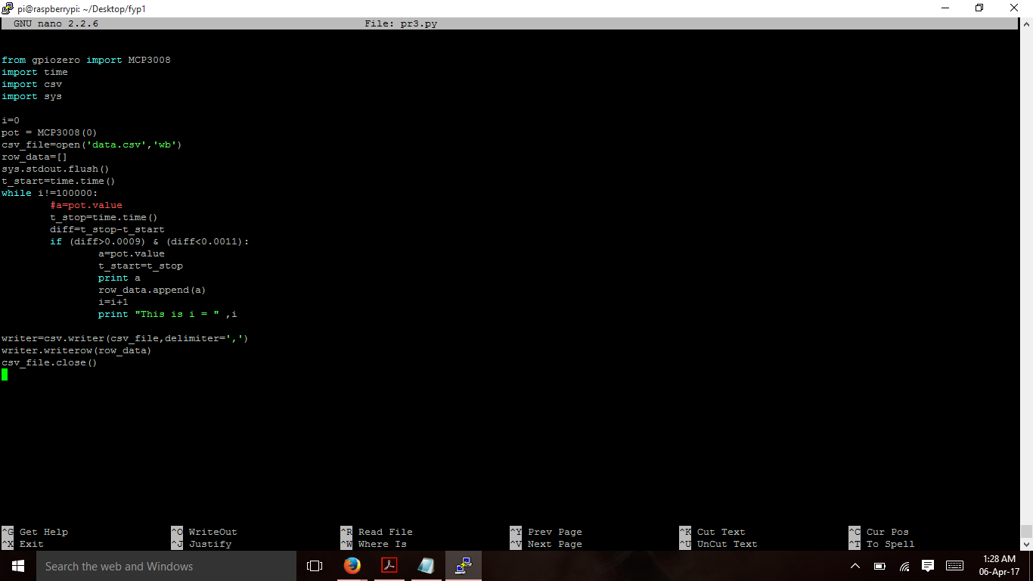
Sensor Interface with R-pi
CSV file generated from the sampled and digitized analog signal
Code to sample at 1kHz

Slide 12
Work Done Since Last Review
APOORV
Worked on ARX modeling of ECG signals
Coefficients were obtained which will be form as additional features for classifier
Interfaced sensor with Raspberry-Pi to obtain CSV file at correct sampling rate
Working on implementing ECG sensor and verifying operation of AD8232

Slide 13
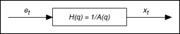
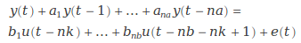
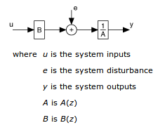
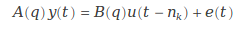
Modelling of Signals
APOORV
AR Model Structure:
ARX Model Structure:

Slide 14
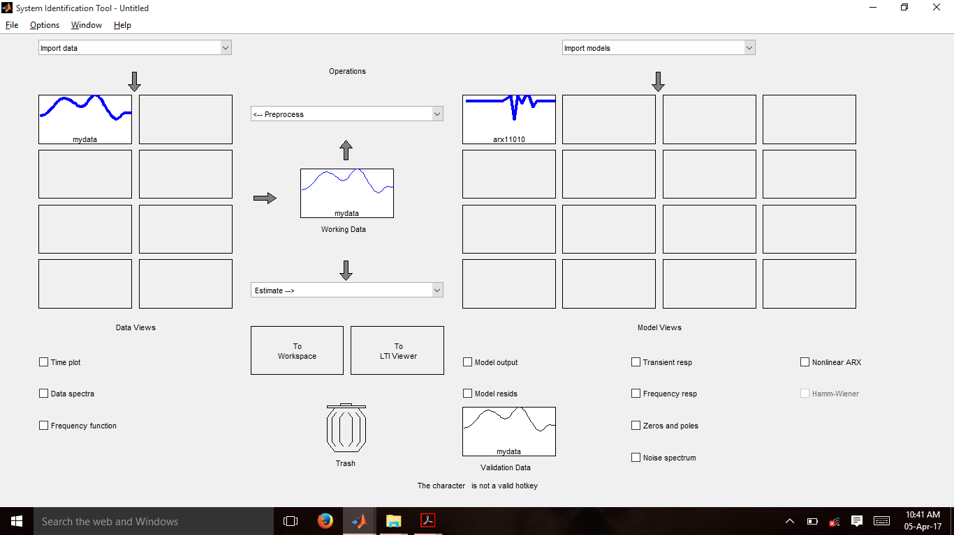
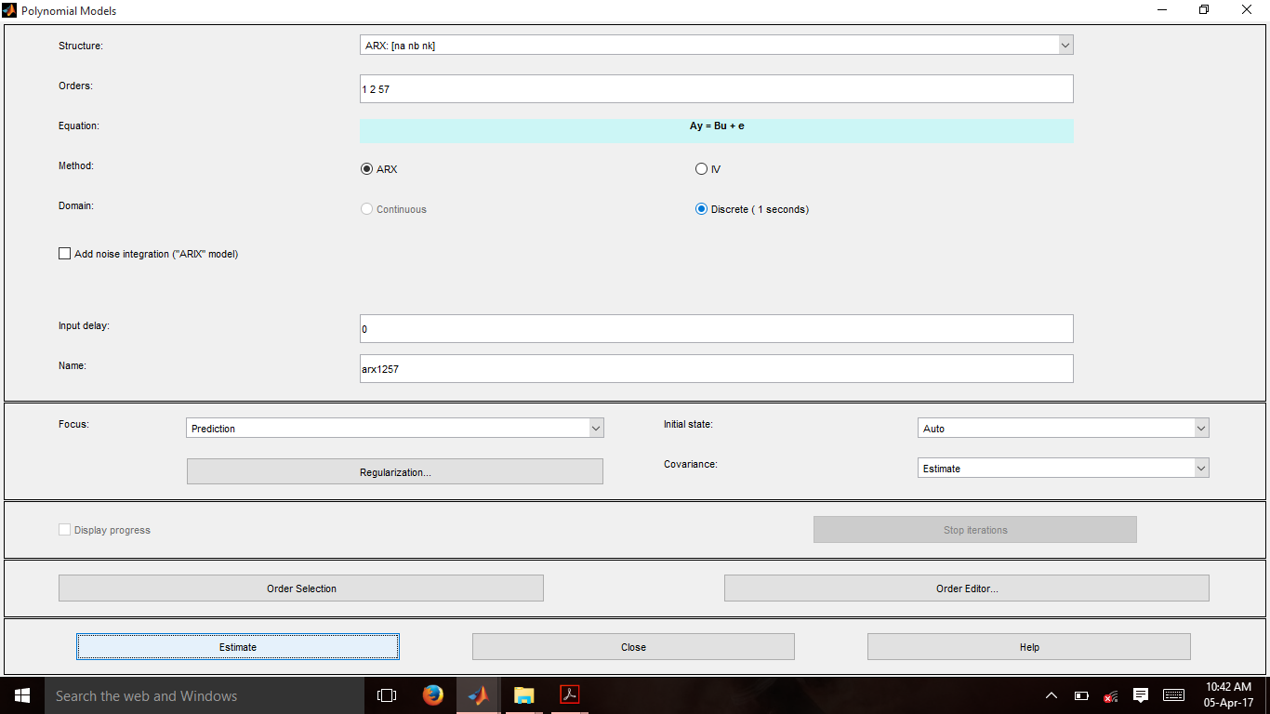
Work Done
System Identification toolbox

Slide 15
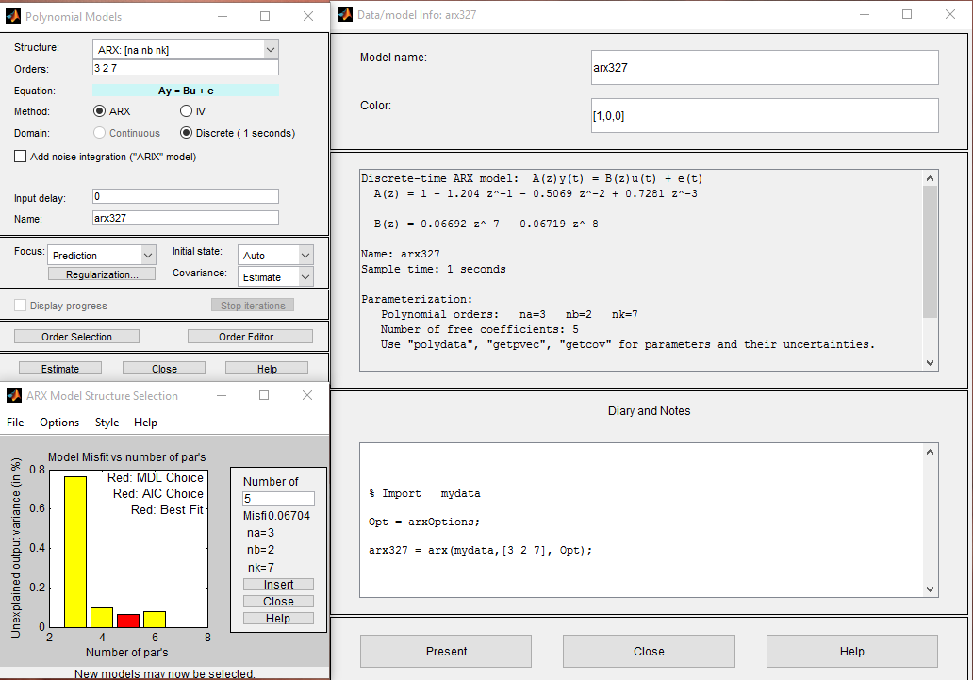
Work Done

Slide 16
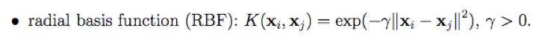
Work Done Since Last Review
AKARSH
Applied self-written Gaussian Kernel to dataset.
Feature dimensions increased from 23 to 67 (i.e., number of samples)
No increase in accuracy observed for classifier with Kernel use (accuracy remained at ~70%) for K-fold cross validation with k=8.

Slide 17
Work Done Since Last Review
AKARSH
Implemented Kernel function in Python and MATLAB
Tested Kernel for varying values of variance (Sigma) from 0.001 to 100.
Highest accuracy was obtained for Sigma=1.111
Understood Meta Cognitive Learning Algorithm for an Extreme Learning Machine Classifier by studying a paper.
Worked on implementing ECG sensor circuit and verifying operation of AD8232 Sensor

Slide 18
MetaCognitive ELM
The architecture of McELM is not fixed a priori
Network is built during the training process
Meta-Cognitive component of McELM has a self regulatory learning mechanism that decides what-to-learn, when-to-learn and how-to-learn
Samples from training set are presented one by one and meta cognitive component chooses suitable learning strategies for the sample
Learning strategies include: deleting sample, adding neuron, updating output weights, or reserving samples for future use

Slide 19
MetaCognitive ELM
Neurons in Hidden layer employ q-Gaussian activation function
Adding a neuron: Centres chosen based on the sample, width of Gaussian function chosen randomly
Output weights estimation: Least square estimate using hinge loss error function
Why Hinge Loss Error Function? It facilitates prediction of posterior probabilities better than mean square error.

Slide 20
What we expect from McELM
Reduced number of hidden layer neurons
Better accuracy
Lesser overfitting
Lesser computational effort
Improvement in generalization capability

Slide 21
TARGETS FOR THE NEXT REVIEW
RAKSHITH
Implement Meta-Cognitive ELM
Implement Classifier section of SVM code in Python
APOORV
Remove dependence on System Identification toolbox and convert everything to command line codes
ARX modeling coefficients to be calculated for all samples and consolidated into a single csv file, one for alcoholics and other for non-alcoholics
Port the frequency domain feature extraction MATLAB code to Python
Integrate hardware and python code on the Raspberry Pi to make a complete system
AKARSH
Implement Meta-Cognitive ELM

Slide 22
Literature Survey
Pico Technoology, “Electrocardiogram (ECG) circuit for use with oscilloscopes”. [Online] Available: https://www.picotech.com/library/application-note/electrocardiogram-ecg-circuit-for-use-with-oscilloscopes
Lv Jinhua and Xu Yanyi, “Circuit Design for Front-End Electrocardiograph”, International Journal of Multimedia and Ubiquitous Engineering Vol.11, No.5 (2016), pp.345-354
Ajay Bharadwaj and Umanath Kamath, Cypress Semiconductor Corp., “Techniques for accurate ECG signal processing” [Online] Available: http://www.eetimes.com/document.asp?doc_id=1278571
NTHU, “ECG Circuits, Signal Sampling and Digitalization” [Online] Available: https://www.google.co.in/url?sa=t&rct=j&q=&esrc=s&source=web&cd=1&cad=rja&uact=8&ved=0ahUKEwins5jwg43TAhWCq48KHcxPAysQFgggMAA&url=http%3A%2F%2Flms.nthu.edu.tw%2Fsys%2Fread_attach.php%3Fid%3D692351&usg=AFQjCNFJqOwwhxZZG0FP1yQNMuNpHBV73Q&sig2=e_-aLgXrLbFMIB-XhTd2Kg

Slide 23
Literature Survey
L. Ljung,“System identification toolbox,” The Matlab user’s guide, 2012. [Online] Available: http://radio.feld.cvut.cz/matlab/pdf_doc/ident/ident.pdf
Hong He, Xiaowen Yan and Wei Wei, “Meridian ECG Information Transmission System Modeling Using NARX Neural Network” ,IEEE/ACIS 15th International Conference on Computer and Information Science (ICIS), 2016. [Online] Available:http://ieeexplore.ieee.org/document/7550775/
R. Savitha, S. Suresh, H.J. Kim, “A Meta-Cognitive Learning Algorithm for an Extreme Learning Machine Classifier” Cognitive Computation, vol. 6, pp. 253-263, 2014.

Slide 24
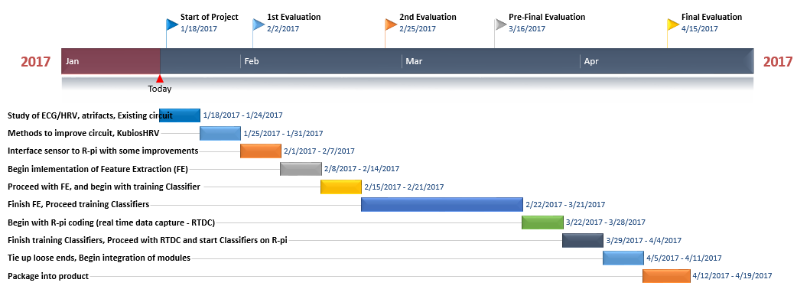
TIMELINE
On schedule as per expected timeline

